Slide 1
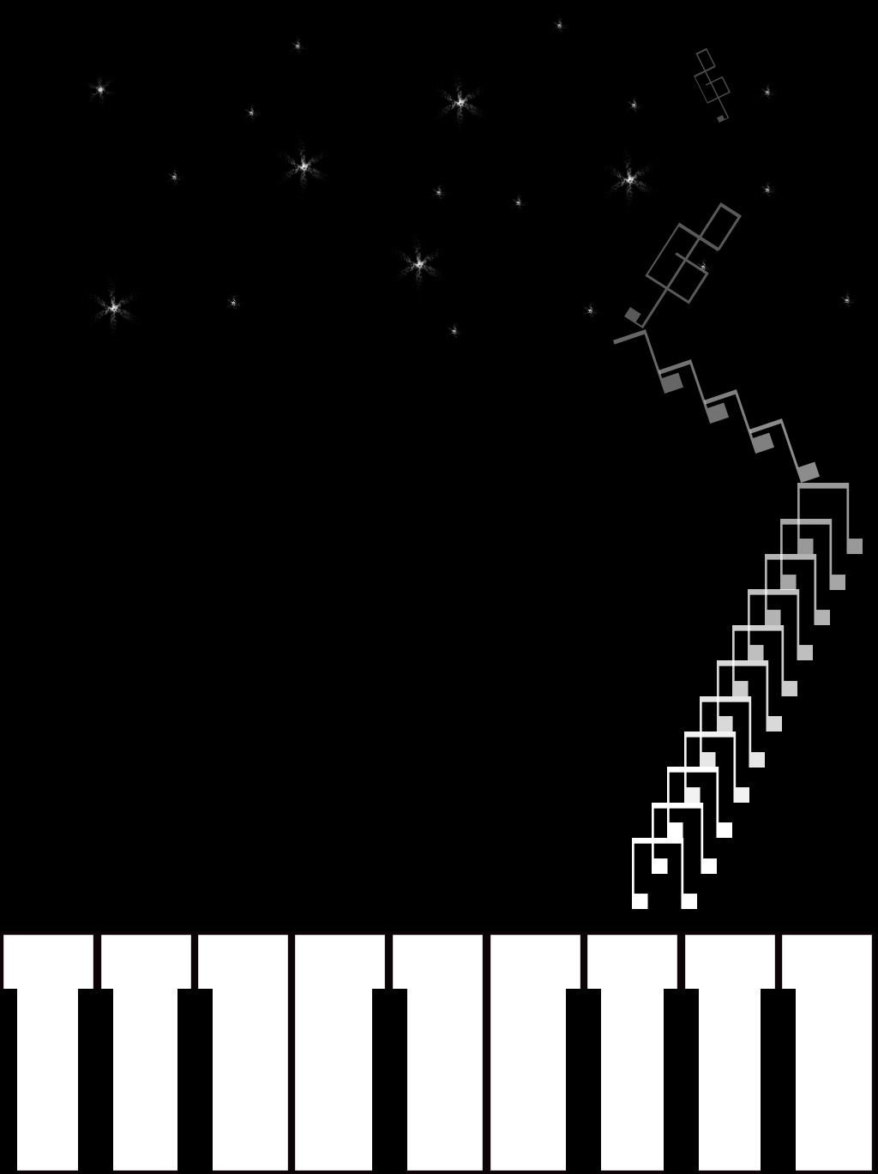
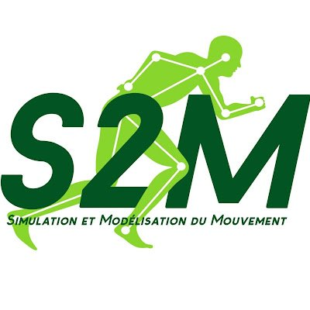
Enhancing Pianists' Whole-Body Gestures: A Synergistic Approach Combining Experimental and Simulation Research
Acronym: EPWG
Enhancing Pianists' Whole-Body Gestures
Mohammadali Shahiri
Laboratory of Simulation and Movement Modeling
[May 2023]

Slide 2
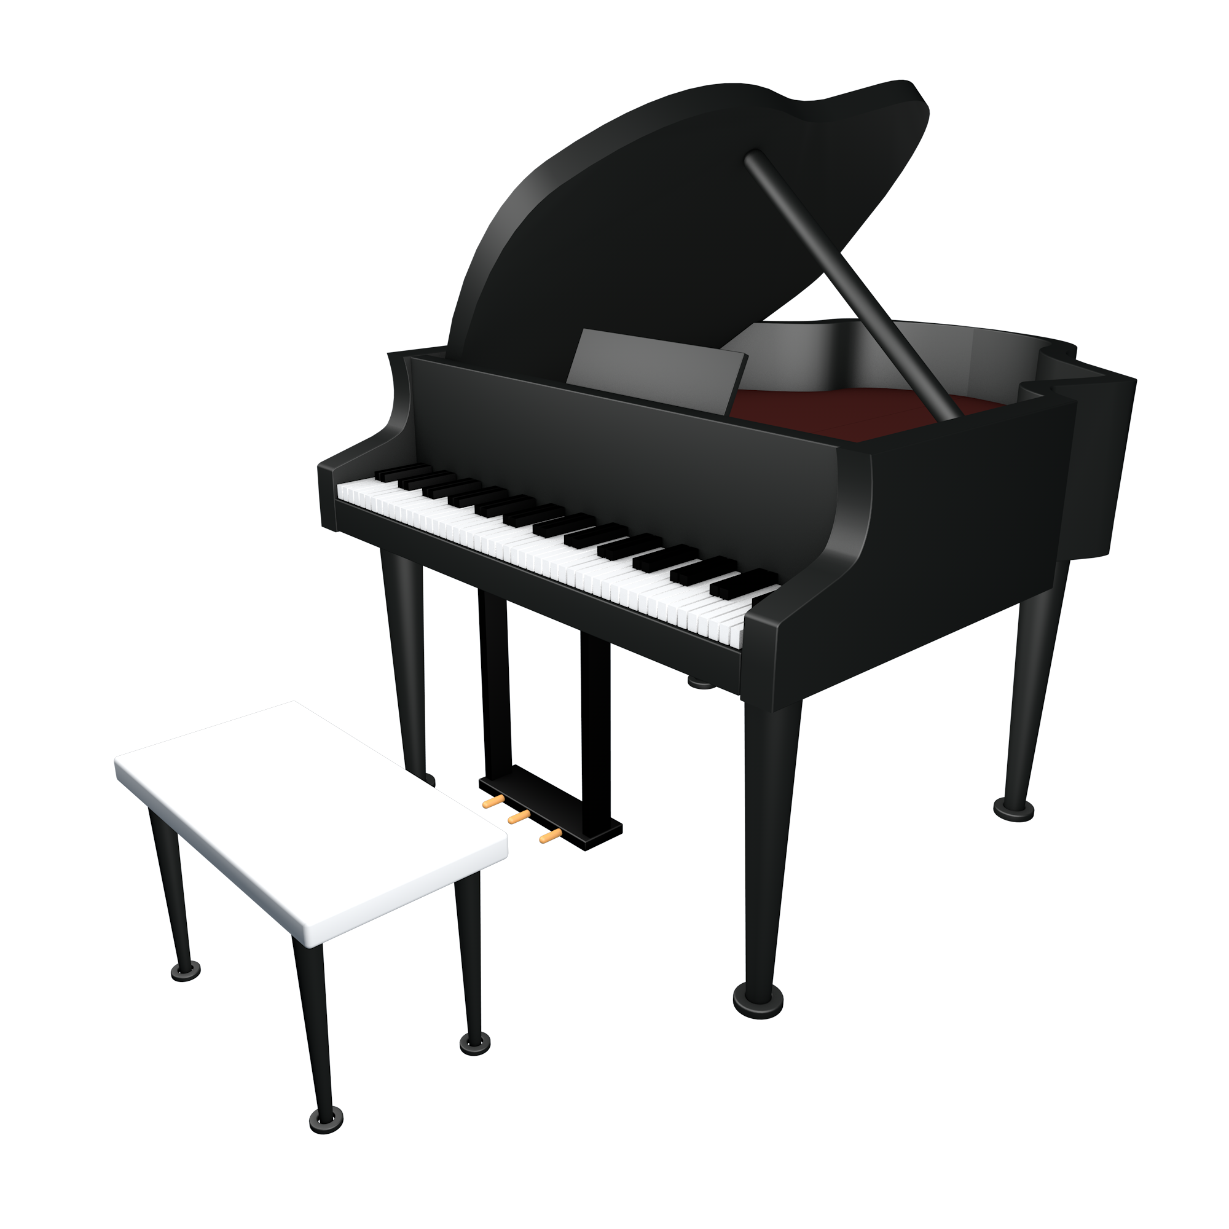
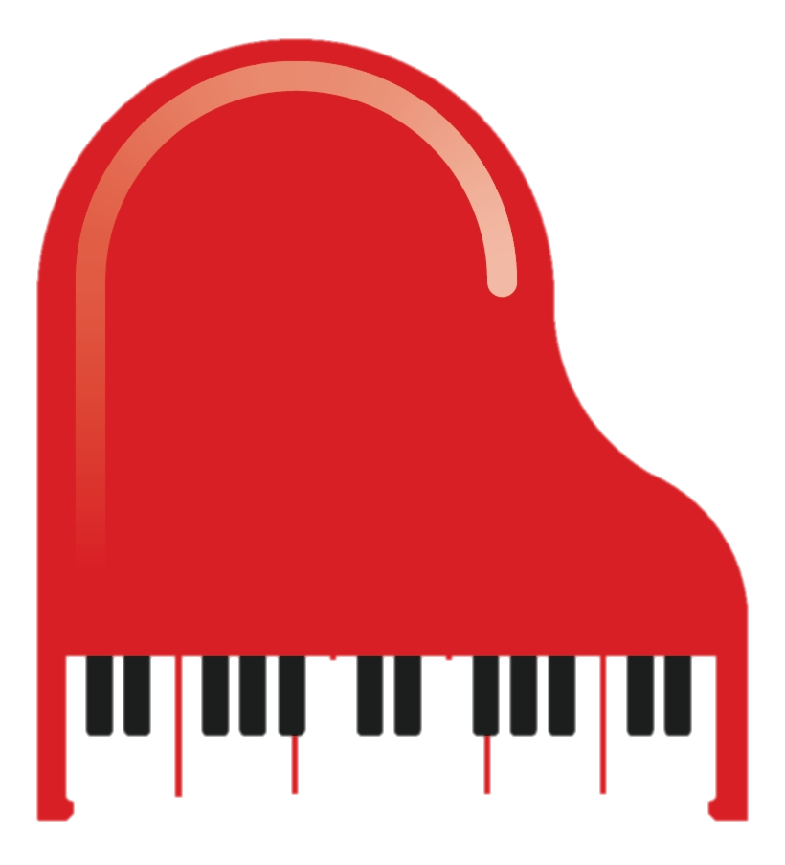
General Insight to Overuse Injuries
Repetitive movements can be observed in various fields at the level of the upper limbs and the trunk:
1. Musicians: Pianists, guitarists, violinists
2. Athletes such as running, swimming, or throwing.
3. Factory workers in assembly lines or packaging goods.
4. Office workers: Typists
5. Artists and Craftsmen: Painting, Sculpting, or Pottery
Professional Pianists
Skill-based Training
Triggering the Possibility of Injury
Daily Practice
Repetition
Overuse vs. Misuse
Numerous terms have been used to describe musicians’ musculoskeletal disorders, including ‘overuse syndrome,’ ‘repetitive strain injury and ‘cumulative trauma disorder.’
Overuse emphasizes the excessive quantity or intensity of use.
Misuse focuses on incorrect or improper usage.
Not everyone who participates in the above activities will necessarily experience problems. Repeated movements must be based on a correct understanding.
1
(Proper Training Techniques)

Slide 3

Repetition
Muscle Fatigue
Changing kinematic Pattern
Changing Force Distribution
1. Decreased Muscle Endurance over time
2. Altered Biomechanics:
Changes in pianists' posture and movement patterns
Placing excessive stress on specific muscles or joints
Localized muscle fatigue Vs. Generalized muscle fatigue
2
Fatigue affects variability

Slide 4
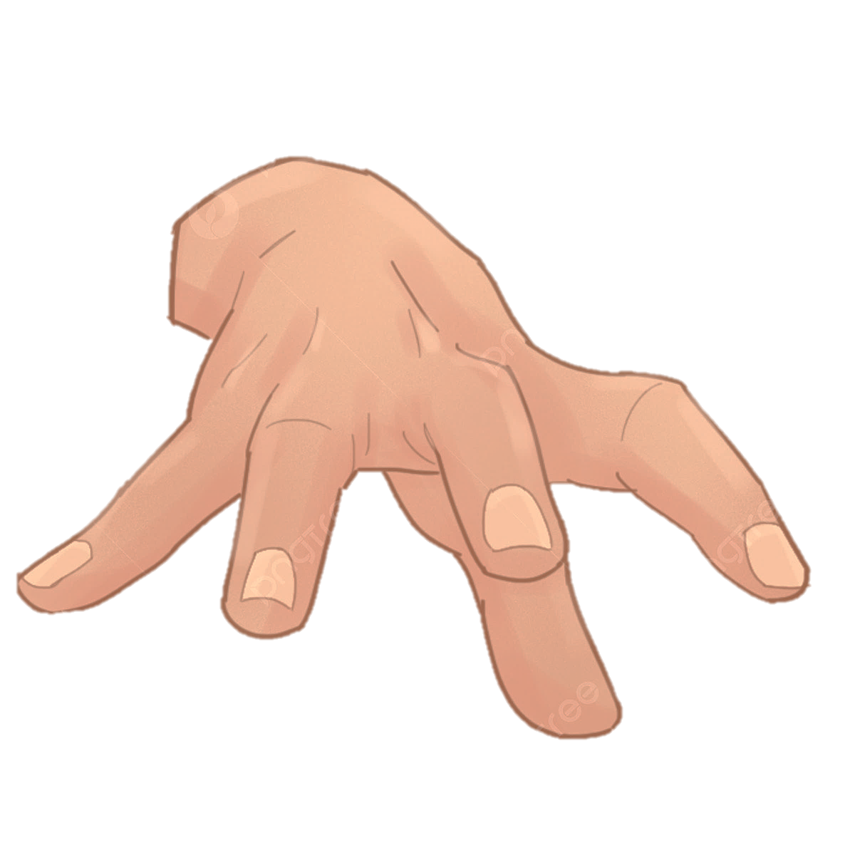
Numerous research studies have focused on examining the playing techniques employed by professional pianists in relation to their upper limbs and trunk.
Our Contribution:
However, No study to date has utilized computer simulation and optimal control methods to address this issue.
This innovative approach offers a unique opportunity to analyze the problem without the requirement of conducting extensive experiments involving a large sample size of participants.
The unique capabilities of Bioptim's control algorithms (Analyzing the impact of different variables on performance) Slide No. 13
Summary
1) The project concerns the study of the piano gesture via digital simulation and the theory of optimal control.
The objective is to discover New Playing Strategies and Multi-joint movement patterns.
better share the load between distal and proximal muscles (Load Distribution)
to reduce exposure to risk factors for PRMDs
related to instrumental practice in professional pianists.
3

Slide 5

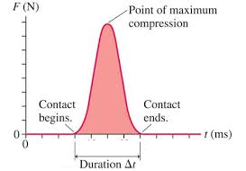
1st Step
Numerical Optimization of Pianists' Movement: Exploring the Pressed Touch and Struck Touch Framework
Two distinct techniques of sound production
"Pressed Touch" Vs. "Struck Touch"
Pressed touch involves the pianist applying gradual and sustained pressure to the keys.
Struck touch is characterized by a quick and distinct striking motion on the keys. In struck touch, the finger makes contact with the key, quickly rebounds off the key surface, and returns to its original position (Maybe not exactly the original position!).
Pressed key: No momentum, and vertical speed is Zero.
Does Struck’s touch on the piano mean IMPACT?
Standard Terminology
4

Slide 6
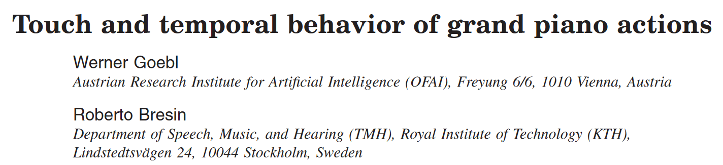
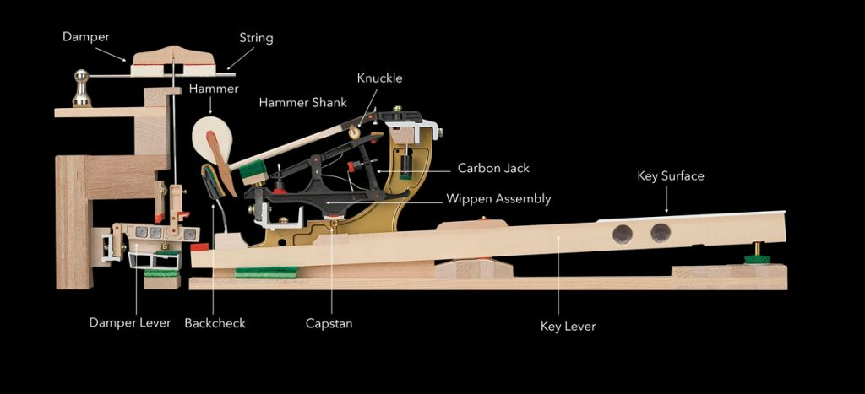
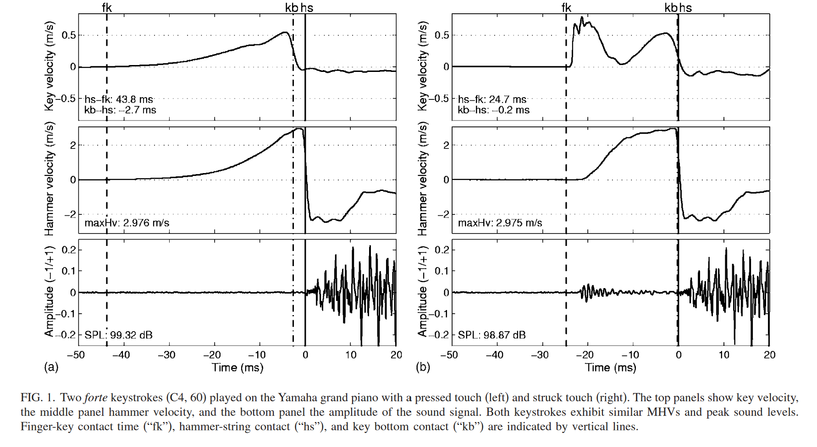
Sound Production
The first keystroke Fig. 1a, From the beginning of the keystroke, the key velocity increases gradually; the hammer velocity grows in parallel. The Hammer reaches its MHV immediately before it arrives at the strings.
Hammer-string contact is characterized by a very sudden deceleration Fig. 1, indicated by vertical solid lines. Key bottom contact shows a slightly less abrupt deceleration, occurring immediately before hammer-string contact.
Fig. 1b shows a very sudden jerk at the beginning of the key movement that has no correspondence with the hammer movement but can be seen in the audio data.
The hammer starts its travel to the strings with a delay of
several milliseconds. It receives a first, larger acceleration by this initial blow applied to the key; it brings the hammer to its final speed.
The whole striking procedure needs roughly 20 ms less time with a struck touch compared to the pressed touch, both with almost identical intensities.
Maximum Hammer Velocity
5

Slide 7
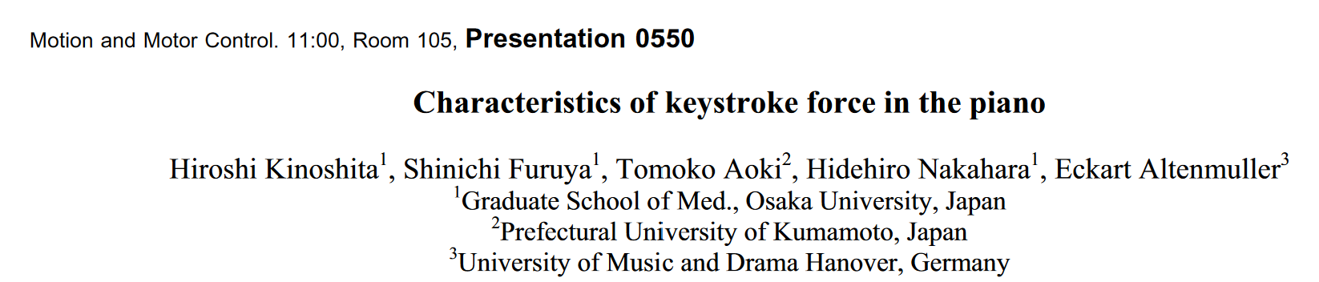
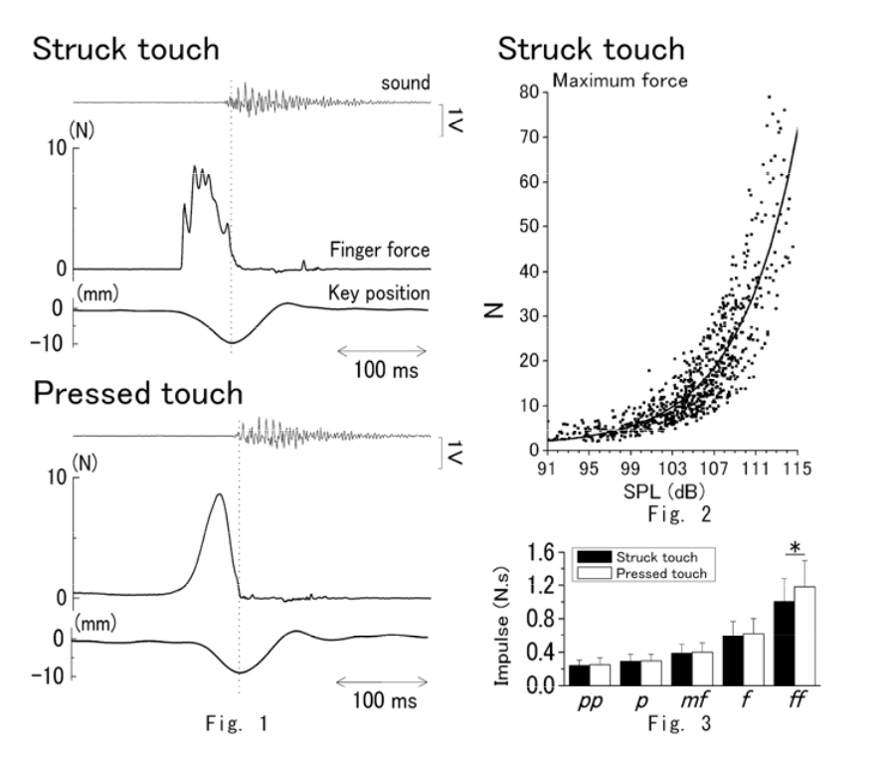
The force profiles for the struck touch were characterized by a rapid rise in force immediately after the finger contacted the key, which was followed by multiple peaks.
The force profiles for the pressed touch, on the other hand, developed more slowly and smoothly, and thus its initial peak was less clear and commonly had a one-peaked pattern.
6

Slide 8

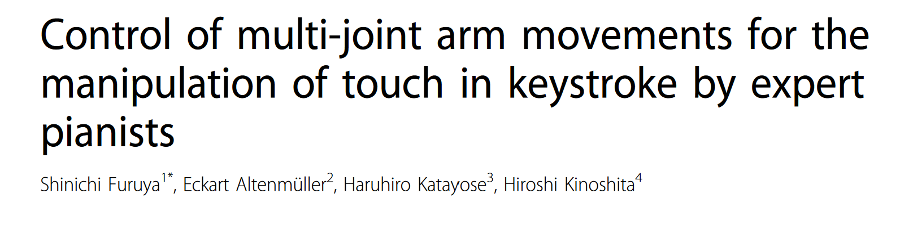
The study investigated differences in kinematics and kinetics of the upper-limb movements while expert pianists were depressing a key with two different touches: pressed and struck. (A preparatory lifting of the arm)
The pressed touch showed smaller elbow extension velocity and larger shoulder and finger flexion velocities during key depression compared with the struck touch. The findings indicated that the pianists compensated for this insufficient elbow speed during the pressed touch by increasing the shoulder and finger velocity in order to reach the finger-tip velocity for eliciting the target loudness of tone.
The authors hypothesized that no preparatory arm downswing in the pressed touch would result in larger elbow extension and wrist flexion accelerations directly attributed to their corresponding MUS and larger shoulder and finger flexion velocities as well as their accelerations induced by the corresponding MUSs, as compared to the struck mode. (MUS: Muscular torque)
7

Slide 9
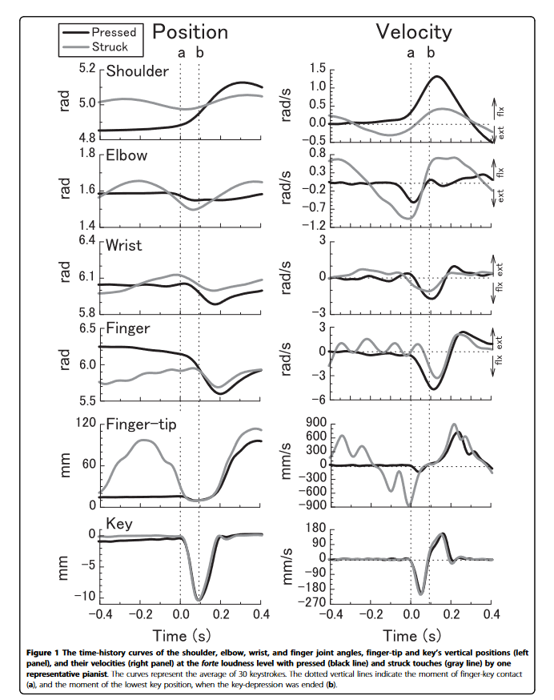
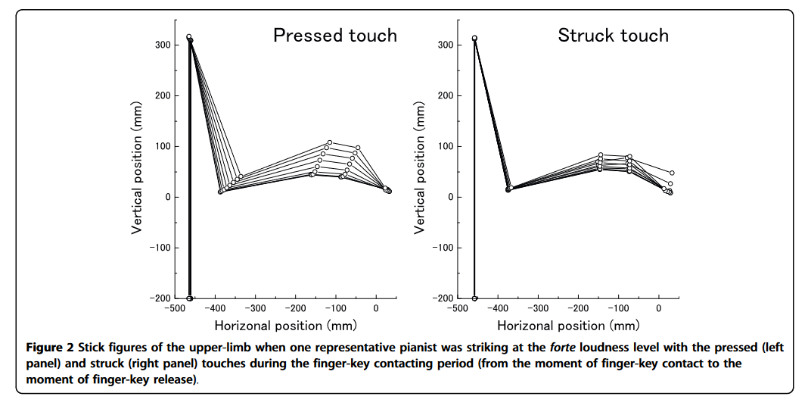
The upper limb's forward and rotational movements were much greater during the pressed touch than the struck one.
8

Slide 10
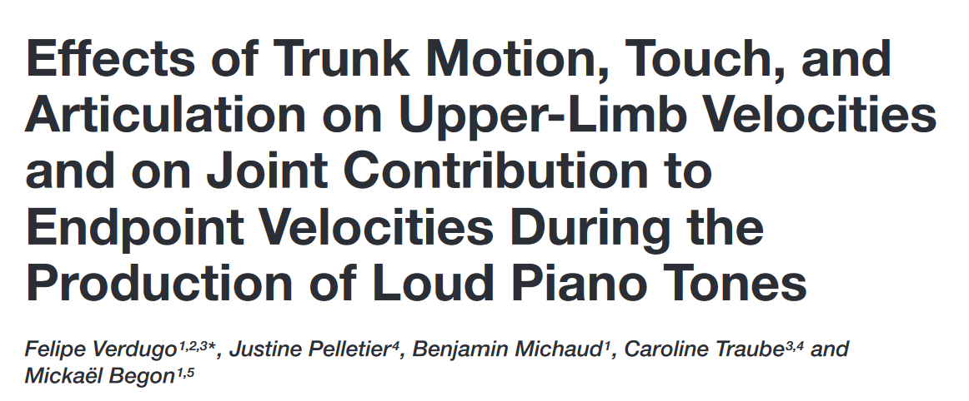
Trunk motion can actively contribute to the generation of velocity and force at the distal end of the kinematic chain. This goal-oriented use of trunk motion might enhance specific performance outcomes and decrease risks of injuries by reducing stress on distal joints and muscles. A similar idea might be applied to piano performance, as it is possible to hypothesize that the pelvis and the thorax could have a relevant impact on upper-limb segments’ velocities and on force generation at the finger–key interaction.
The majority of these disorders appear in the muscles and tendons associated with the distal joints, ie, wrists and fingers.
The use of the pelvis and thorax specifically is an adaptable strategy that would seem suitable.
To minimize exposure to MSD risk factors, pianists could take advantage of the multi-joint movement of the upper limbs to better share the load between the distal and proximal muscles.
9

Slide 11
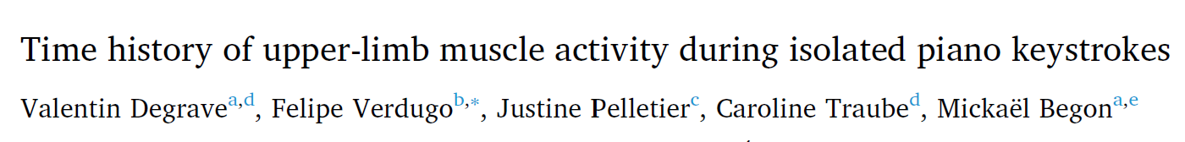

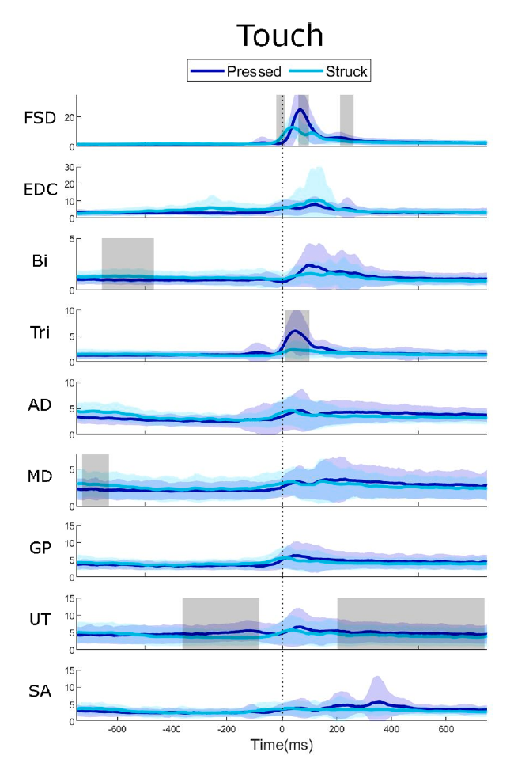
The pressed touch prime mover muscle was the triceps brachii, while struck touch entailed progressive deactivation of anti-gravity muscles before the keystroke.
Biomechanical studies Vs. Musicology
My Intuition:
YOU did some experiments and analyzed the kinematic and kinetic sides of the piano performers during pressed and struck touch.
2) In this step, We should develop a model, and for the validation Process, we compare the results with our previous experimental setups.
3) Muscle Fatigue & Golden Standard Approach
Color lines and clouds represent mean muscular activations plus or minus one standard deviation in %MVC. Grey boxes represent the periods of significant difference. The vertical dotted line indicates the beginning of the key descent.
FDS = flexor digitorum superficialis,
EDC = extensor digitorum communis, Bi = biceps brachii,
Tri = triceps brachii, AD = anterior deltoid, MD = middle deltoid,
GP = great pectoral, UT = upper trapezius, and SA = serratus anterior.
The initial velocity of the fingertip obtained by the gravity drop of the arm during struck touch was compensated by increased activation of the triceps and the flexor digitorum superficialis during pressed touch.
10

Slide 12


Slide 13
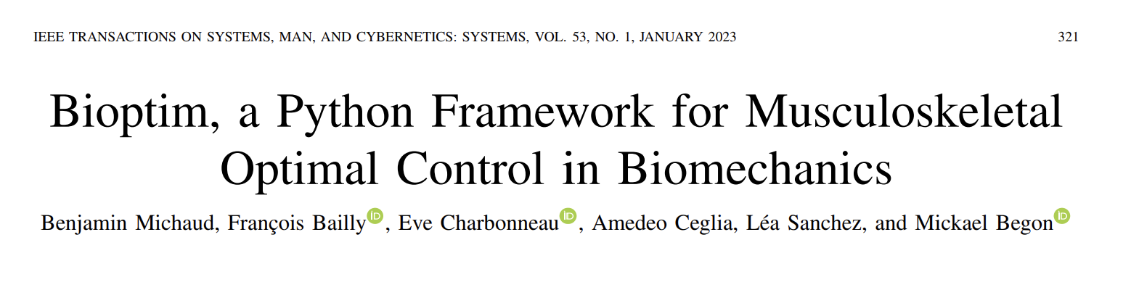
In the field of biomechanics, musculoskeletal simulations serve as valuable tools for a variety of purposes.
Firstly, these simulations are utilized to investigate the root causes of movement disorders. By simulating the movements typical of these disorders, researchers can better understand why these disorders occur and potentially discover new treatment methods.
Secondly, musculoskeletal simulations can be used to estimate physiological quantities that are challenging or impossible to measure directly. This could involve factors like the forces exerted on specific joints during particular movements or the tension and strain experienced by muscles and tendons under different physical stresses. These estimations can be useful for a variety of applications, including the design of more effective physical therapy programs.
Finally, these simulations can be employed to study the optimality of human movement. In other words, they can help researchers understand what constitutes the most efficient, least injury-prone way of moving. This could be particularly useful in fields such as sports science, where small improvements in movement efficiency can lead to significant performance gains, or in physical rehabilitation, where optimal movement strategies can aid recovery and prevent re-injury.
17

Slide 14
Direct Multiple Shooting Vs. Direct Collocation
In the simplest terms, both methods aim to find the optimal control inputs for a system, but they do so in slightly different ways. Direct multiple shooting focuses on integrating the system's equations forward in time and adjusting initial states, while direct collocation focuses on enforcing the system's equations at specific points in time.
Direct Multiple Shooting Method:
Imagine the self-driving car has to travel from point A to point B. The multiple shooting method would split the journey into smaller segments or intervals. In each segment, the car calculates the optimal speed and direction to reach the next point based on current conditions (traffic, road conditions, etc.). These calculations are independent of each other for each segment but will eventually connect the starting point (point A) to the destination (point B) [Integration]. This method is like a relay race where each runner (or in our case, each segment of the journey) does its part independently, but their combined effort achieves the overall goal.
Direct Collocation Method:
In contrast to the multiple shooting method, the direct collocation method considers the entire journey from point A to point B as one entity. The car would analyze the entire route and calculate the optimal path and speed for the entire journey at once. Instead of splitting the route into segments, the car plans its path considering all factors at once (traffic, road conditions, etc.) and adjusts its control input (speed, direction) throughout the journey based on this one solution. This method is like a marathon race where the runner plans and strategizes the entire run before starting.
18

Slide 15
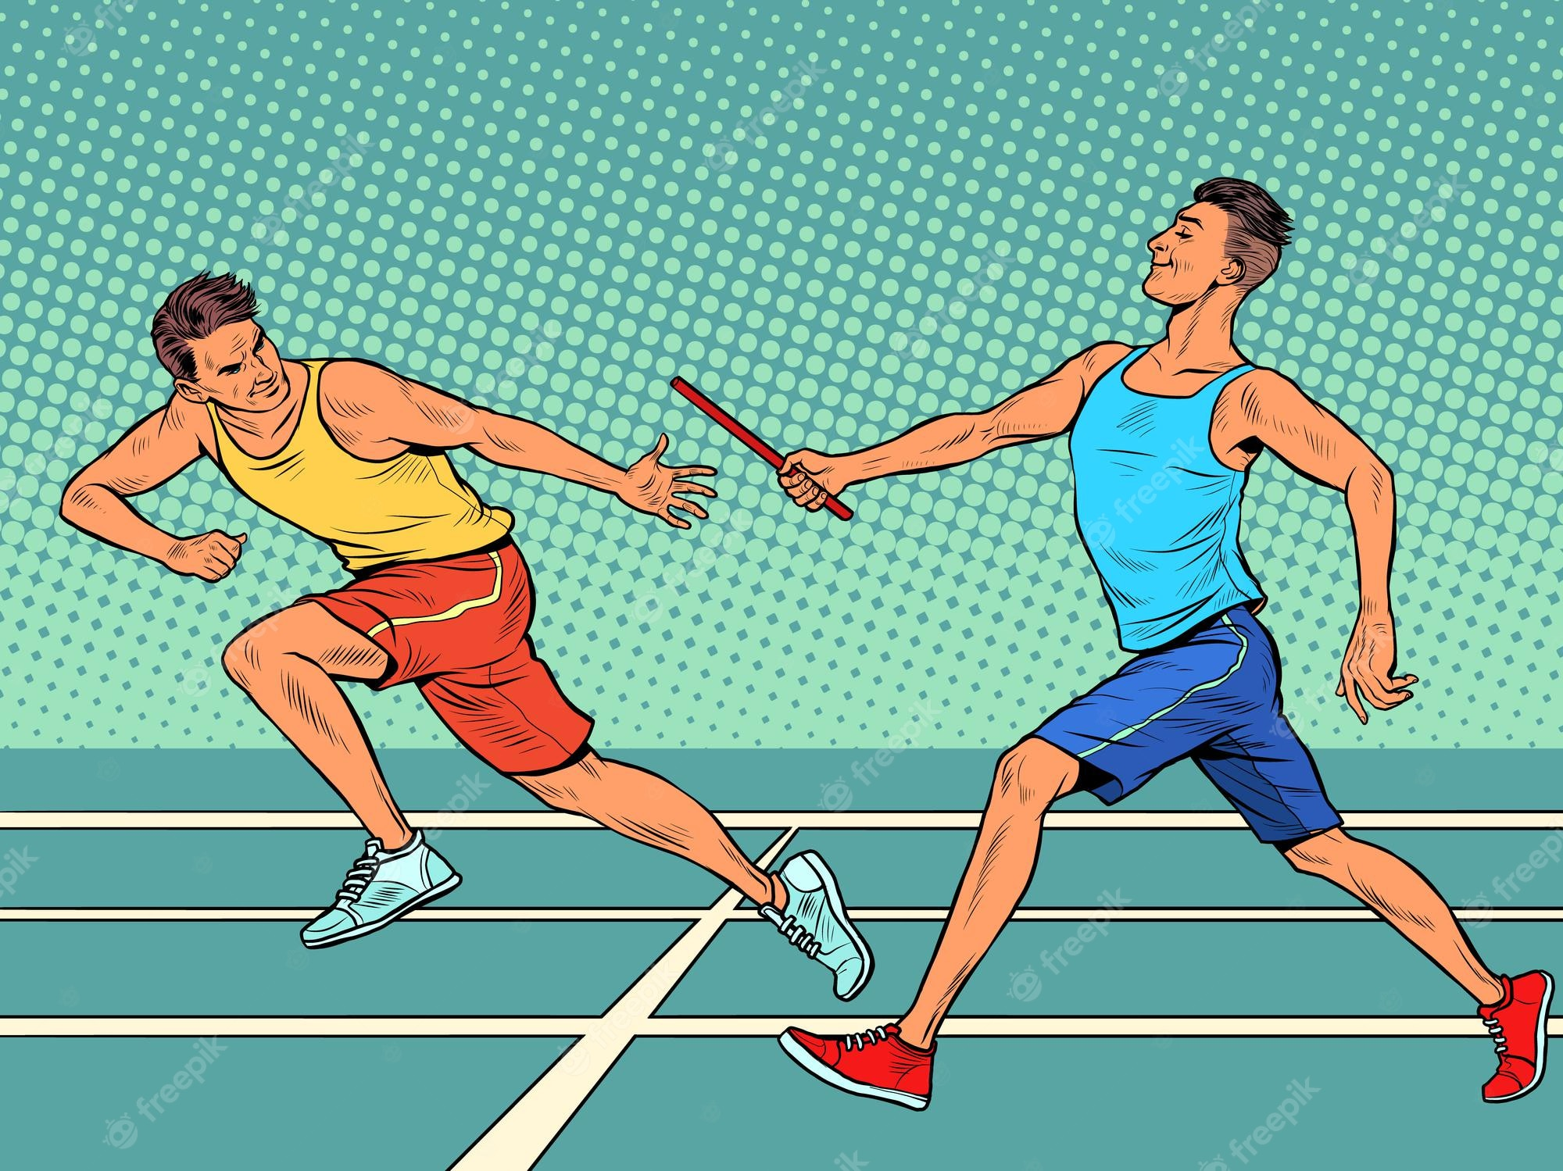
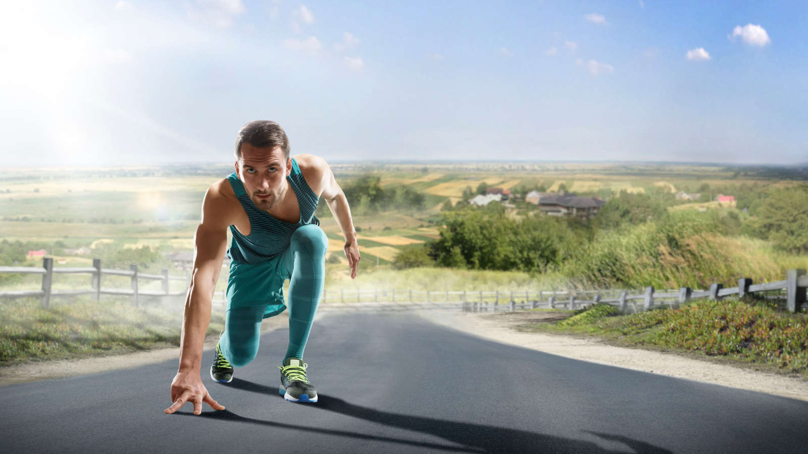
Direct Multiple Shooting Vs. Direct Collocation
Relay Race
marathon Race
19

Slide 16
Direct Method | Indirect Method
The term "direct methods" in the context of optimal control refers to a set of numerical methods for solving optimal control problems. These methods transform the OCP into a nonlinear programming (NLP) problem, which can be solved using standard NLP solvers. The "direct" term is used because these methods directly convert the problem of finding an optimal function (which is an infinite-dimensional problem) into a problem of finding optimal values at a finite set of points (a finite-dimensional problem). | In the indirect approach, the car would first calculate the optimal path (the one that uses the least fuel) from A to B without considering the obstacles and speed limits. After this path is calculated, the car would then adjust this path based on the constraints (like obstacles and speed limits). If an obstacle is detected on the path, the car will calculate a detour around the obstacle that still tries to stick as close as possible to the original optimal path. The car continues to make these adjustments as it moves along the path from A to B. The indirect method first calculates the "ideal" path and then adjusts it based on real-world constraints. This is why it's called "indirect": the solution is not directly based on the constraints but is instead an adjustment of the ideal solution.
20

Slide 17
Optimization Algorithms:
Interior point methods (Ipopt) Vs. Sequential quadratic programming (SNOPT and Acados)
21
Ipopt (Deterministic, when the mathematical model and system parameters are well-defined) | Acados (Robust solvers, on the other hand, consider uncertainties and variations) Needs Good initial Guess
Suppose you're a delivery driver who delivers packages to a certain destination. The catch is that the roads are very hilly, and you want to find the route that will consume the least fuel - this is your optimization problem. If you were to use an interior point method (like Ipopt), you would start somewhere in the middle of the city (interior), instead of at the boundaries. [Like solving a puzzle by considering the boundaries or middle piece]You would then drive a little in every possible direction to see which direction seems to be going "downhill" the most - that is, which direction leads you towards your destination while consuming the least fuel. You'd then drive a little bit in that direction and repeat the process, each time updating your idea of which way is "downhill.” You continue this until you reach your destination. | Navigating a hilly city to understand the concept of simplifying a problem and iteratively updating the solution. Imagine you are driving in a hilly city, and you want to reach a specific destination. It would start by simplifying the problem. In this simplification process, you would approximate the hilly city as flat, neglecting the detailed topography. Following the simplified city's road network, you begin driving along this planned route. After a while, you stop and observe the actual city around you. At this point, you update your approximation based on your current location and the observed city landscape. With the updated approximation, you plan a new route that takes into account the actual hills and road conditions you see around you. You then continue driving along this new route, adhering to the updated approximation. Again, after some time, you stop, assess the city's terrain, and update your approximation once more. You repeat this process of driving, stopping, observing, and updating your approximation until you finally reach your destination in the hilly city. Each iteration allows you to refine your understanding of the city's topography and adjust your route accordingly, making the necessary adaptations to navigate the challenging terrain. This iterative approach, where you progressively refine your approximation and adjust your solution based on real-time observations, is similar to the way optimization algorithms work.

Slide 18
22
Finite Differences: This is a simple and straightforward method, but it's often imprecise. Here's a metaphor: imagine you're trying to measure the steepness of a hill. You could take one step up the hill, see how much higher you are, and use that to estimate the slope. But this estimate could be quite off if the hill is bumpy or uneven. That's the problem with finite differences - it approximates the derivative by looking at how much the function changes with a small step, which might not be accurate if the function is complex or changes quickly.
Automatic Differentiation: This more sophisticated method can compute exact derivatives, even for complex functions. Going back to our hill metaphor, it's as if you had a precise topographical map of the hill that tells you the exact steepness at every point.
The mentioned CasADi is a tool that's often used for automatic differentiation because it allows you to express your function and its dependencies in a symbolic form easily.

Slide 19
CasADi is a symbolic framework for automatic differentiation and optimal control.
Here are some key points about CasADi:
Symbolic computation: CasADi allows for the symbolic computation of mathematical expressions, which means you can compute the derivatives and integrals of functions symbolically rather than numerically. This can provide more accurate results and can be more efficient for complex expressions.
Automatic differentiation: CasADi uses automatic differentiation to compute derivatives exactly, rather than numerical approximation methods. This can lead to more accurate results, especially for complex functions or large-scale problems.
Interfacing with other software: CasADi can interface with other software for numerical computation, such as Ipopt, allowing you to use the best tools for each part of your problem.
Open-source: CasADi is open-source.
23

Slide 20
Bioptim is an essential component within a suite of libraries that includes Biorbd for dynamics and musculoskeletal modeling [an editable text file including the Geometry, Segment Inertial Info, Muscle and Joints, Boundaries], CasADi for automatic differentiation, Ipopt/Acados for optimization, and Bioviz for visualization. Bioptim serves as the top layer, connecting and coordinating the functionalities of these libraries.
Bioptim acts as a crucial component in the suite of libraries, providing a connection between the various dependencies for dynamics, modeling, differentiation, optimization, and visualization. It offers a user-friendly interface while maintaining efficiency and customizability through its Python frontend and C/C++ backend.
24
Bioptim Vs. OpenSim
OpenSim has just one solver (Ipopt) and transcription method, Direct collocation.
OpenSim is based on C++. Software Users vs. Developers (Introducing the new Objective Function)
OpenSim doesn’t have the ability for Multiphase OCP.

Slide 21
The Optimal Control Problem (OCP) comprises multiple stages, each representing a separate Nonlinear Programming Problem (NLP) within the overall OCP framework.
The NLPs in each stage consist of several programming attributes, which are essential components for defining and solving the optimization problem.
Here are the key attributes of each NLP within the OCP:
Dynamics: The dynamics describe the mathematical equations that govern the behavior of the system being controlled. It represents the relationship between the state variables, control inputs, and their time derivatives.
Objective Functions: Objective functions specify the optimization goals or criteria that need to be either maximized or minimized.
Constraints: represent the conditions or limitations the system must satisfy during optimization. These can include equality or inequality constraints.
Bounds: Bounds define the allowable ranges or limits for the variables involved in the optimization problem.
Discretization Intervals and Duration: The OCP is divided into discrete intervals to facilitate numerical computation.
Initial Guess: An initial guess provides an initial estimation of the variables involved in the optimization problem. It serves as a starting point for the solver and can significantly affect the convergence and quality of the optimization solution.
Based on these inputs, Bioptim configures the OCP transcription by utilizing direct multiple shooting or Legendre/Radau direct collocation methods. These methods ensure that the dynamics are satisfied at appropriate points during the optimization process. The problem is then shaped to match the requirements of the chosen nonlinear solver, such as Ipopt or Acados.
Finally, the different attributes of each NLP, including dynamics, objective functions, constraints, bounds, discretization, and initial guess, are developed and defined to construct the individual NLPs within the multistage OCP framework.
25

Slide 22
In the context of optimization and dynamics modeling, "Controls" and "States" refer to two different types of variables that play distinct roles in the system being analyzed.
Controls are variables that represent the inputs or actions applied to the system. Controls are often associated with the control inputs or forces that can be applied to the system, such as muscle excitations, muscle activations, joint torques, or external forces.
States are variables that describe the system's internal state or configuration at a given time. They represent the system's behavior and evolve over time based on the dynamics and the inputs (controls) applied to the system. States can include variables such as joint angles, joint velocities, muscle activations, or any other variables that capture the system's internal state.
To summarize, controls are the inputs or actions applied to the system, while states represent the internal configuration or behavior of the system. The optimization algorithm manipulates controls to find the best values, while states evolve over time based on the system's dynamics and the applied controls. The interplay between controls and states allows the optimization process to determine the optimal inputs and trajectories that achieve the desired goals in the given system.
26

Slide 23
Bioptim provides a feature called parameter scaling, which is useful when the optimal values of certain parameters in the optimization problem differ significantly in magnitude. This scaling capability addresses the issue of convergence that may arise due to the disparate scales of these parameters.
Convergence Improvement: The optimization algorithm is better equipped to handle the optimization problem by scaling the parameters. It helps prevent the domination of certain parameters over others, ensuring a more balanced optimization process.
Bringing the parameters to a similar order of magnitude enables a fair comparison and adjustment during optimization.
27

Slide 24
Two types of objective functions, Lagrange and Mayer:
Lagrange Objective Function: Imagine we have a robotic arm that needs to perform a smooth trajectory from an initial position to a target position within a specific time frame. In this case, a Lagrange objective function could be defined to minimize the joint torques exerted by the robot throughout the entire trajectory. The objective would be to find control inputs (joint torques) that result in smoother and more energy-efficient movements, promoting the efficient use of the robotic arm's actuators. The Lagrange objective function would be integrated over the entire duration of the movement to evaluate the overall torque exertion.
Mayer Objective Function: Continuing with the robotic arm example, let's say we have a specific requirement that the end-effector of the arm must reach the target position precisely at the final time instant. A Mayer objective function could be defined to minimize the distance between the end-effector position and the target position at that specific time point. The optimization algorithm would then aim to find control inputs (joint torques) that ensure the robotic arm accurately reaches the target at the desired time, considering factors like accuracy and final position.
To summarize, in the context of optimizing a robotic arm movement, the Lagrange objective function focuses on minimizing joint torques over the entire trajectory to promote smoother and more energy-efficient motions. On the other hand, the Mayer objective function emphasizes achieving precise positioning at the final time instant, ensuring accurate reaching of the target.
28

Slide 25
Concept of shooting points and problem duration in the context of direct optimization approach using Bioptim:
Shooting Points: In direct optimization approaches, the total duration of the problem is divided into smaller intervals or segments, and the initial values of these intervals are referred to as shooting points. In Bioptim, the user specifies the number of intervals or shooting points to be used in each phase of the optimization problem. These shooting points act as discrete time points at which the optimization algorithm evaluates the system variables and calculates the dynamics, constraints, and objective functions.
Problem Duration: The problem duration is the total time span considered for the optimization problem. In Bioptim, the user defines the problem duration for each phase of the optimization. This duration can be a fixed value or even part of the optimization variables, allowing for dynamic problem durations.
By dividing the problem duration into smaller intervals represented by shooting points, Bioptim facilitates the discretization and evaluation of the system dynamics, constraints, and objectives.
29

Slide 26
Visualization
Bioptim offers several visualization tools to enhance the analysis and interpretation of the optimized variables and solutions. One of these tools is Bioviz, a three-dimensional (3-D) visualizer that animates the solution, providing a dynamic representation of the musculoskeletal system and its movements.
In addition to Bioviz, Bioptim generates online-generated figures inspired by the real-time graphics from Muscod-II. These figures allow users to visualize the optimized variables at each iteration of the solver, providing insights into the optimization process and the changes in variables over time.
To facilitate further analysis and post-processing, Bioptim leverages the Python pickle library. This library enables easy saving and loading of the Optimal Control Problems (OCPs), allowing users to store the OCPs for later analysis and examination of the results.
30

Slide 27
Fast solvers, such as Acados, can efficiently solve complex problems using multistart approaches. This approach helps overcome the issue of getting stuck in local minima, which can be a challenge in optimization. Acados also allows for obtaining initial solutions from simpler problems, which can guide the resolution of more challenging problems.
On the other hand, robust solvers like Ipopt are beneficial when the user lacks specific information about the solutions they are seeking. These solvers do not rely heavily on a good initial guess and are capable of handling a broader range of optimization scenarios.
In the field of biomechanics, studies often involve scenarios where the dynamics or objective functions change over time. This can occur due to factors such as the loss or gain of contacts or the presence of time-varying biomechanical tasks. When it comes to tracking or predicting such motions, these changes result in multiphase optimal control problems (OCPs).
One limitation of OpenSim Moco is that it currently does not provide the capability to handle multiphase OCPs.
31

Slide 28
In Bioptim, there is a flexible mechanism to handle constraints and objective functions in the optimization process.
Let's take the example of a biomechanical task, reaching a target or performing cyclic motions. Initially, you can specify this requirement as a Constraint called TRACK_STATE, which ensures that the final state of the model matches the desired configuration. However, suppose the optimization problem struggles to converge with this constraint. In that case, you have the option to convert it into an objective function with the same name but with a higher weight assigned to it.
By transforming the constraint into an objective function, the solver prioritizes minimizing the discrepancy between the final model configuration and the desired configuration. The higher weight amplifies the importance of achieving the desired final state, nudging the solver toward finding a feasible solution that satisfies the constraint.
In summary, Bioptim empowers users to adapt their optimization problems by dynamically adjusting constraints and objective functions. This feature aids in addressing convergence challenges and finding feasible solutions in biomechanical tasks where certain constraints, such as enforcing specific final configurations, are crucial.
32

Slide 29
While Biorbd offers a straightforward approach to defining new models using the .bioMod file format, it's important to note that Biorbd does not include a graphical user interface (GUI) specifically for building models. Instead, users can translate existing models from OpenSim into the .bioMod format.
Biorbd is limited to supporting only one wrapping object per muscle and rigid tendons. Wrapping objects are used to simulate the interaction between muscles and anatomical structures, such as bones or other tissues, by defining the path the muscle takes around these structures.
By acknowledging these limitations and exploring alternative methods, Biorbd provides a robust and versatile platform for modeling and analyzing musculoskeletal systems in the field of biomechanics.
33

Slide 30
Internship Reports Review
34
Multi-joint movement of the upper limb refers to coordinating the movement of all these joints to perform a particular task.
"Better sharing the loads between distal and proximal muscles" refers to the idea that when these movements are coordinated correctly, the workload of moving and controlling the limb can be more evenly distributed across all the associated muscles.
Why is this important?
It can improve efficiency, prevent fatigue, and reduce the risk of injury.
Becoming overworked leads to strain or other injuries. Meanwhile, other muscles may become underused and weakened.
By engaging a broader range of muscles and moving multiple joints in a coordinated way, the load is more evenly distributed, leading to a healthier and more efficient use of the body's musculature.
This is also a critical concept in areas such as physical therapy, sports training, and ergonomics, where understanding and optimizing the distribution of muscular load can aid in recovery from injuries, enhance athletic performance, or improve the design of tools and workspaces.

Slide 31
Consider a biomechanical model of a human arm performing a reaching task. The goal is to optimize the movement trajectory of the arm to reach a target point while considering the muscle activations and joint torques.
Viapoints: In this approach, you can define specific Viapoints along the desired trajectory of the arm movement. For example, you can specify Viapoints at the starting, intermediate, and target positions. These viapoints serve as landmarks that the optimization algorithm must ensure the arm passes through during the movement. By including these viapoints as constraints or objectives in the optimization problem, the algorithm will shape the trajectory to ensure the arm follows the desired path.
2. Preprocessed Moment Arms: In this approach, you calculate and store the moment arms of the muscles beforehand. Moment arms represent the lever arm or the perpendicular distance between the muscle line of action and the joint axis. Instead of directly considering multiple wrapping objects to simulate muscle-bone interactions, you express the moment arms as polynomial functions of the degrees of freedom (DoFs) that intersect with the muscle. For example, the moment arm of a biceps muscle can be expressed as a function of elbow flexion angle. These pre-computed moment arms are then used during the optimization process to evaluate muscle-tendon forces and optimize the movement. Using preprocessed moment arms avoids the computational complexity and optimization challenges associated with multiple wrapping objects.
35

Slide 32
36
A viapoint, in the context of biomechanics and musculoskeletal modeling, is a reference point or position that is defined within the motion trajectory of a system or a joint. It serves as a key landmark or target location that the system or joint is expected to pass through during its movement. Viapoints are often used to guide and optimize the desired motion or movement pattern.
Viapoints provide a way to incorporate specific constraints or objectives in the analysis and optimization of biomechanical systems. By defining viapoints along a trajectory, researchers and engineers can impose specific requirements on the motion, such as ensuring certain body parts or joints reach certain positions or orientations at specific times. By including viapoints in the modeling and optimization process, researchers can fine-tune the desired motion trajectory and ensure that the simulated or analyzed system follows the desired path with precision.
Viapoints are a useful tool in biomechanics research, as they allow for the customization and control of motion patterns in various applications, such as rehabilitation, sports analysis, and ergonomics.

Slide 33
Git, GitHub, and GitKraken
37
SCS: Source Control System
To track our code changes, Save an initial version, update the version, and compare… Switch between different versions. Who made the changes?
Github: Online website for keeping the repository
Clone: Bring the repository that is hosted somewhere like Github into your local machine
Repo. Is a complete project.
Readme.md ---- md:markdown

